Slide 1

CS47: Cross-Platform Mobile Development
Lecture 1B: Introduction to Javascript (ES6)
James Landay
Abdallah AbuHashem
Tiffany Manuel
Cisco Vlahakis
Vy Mai
Fall 2019
https://cs-47.stanford.edu
cs47-fall19.slack.com

Slide 2
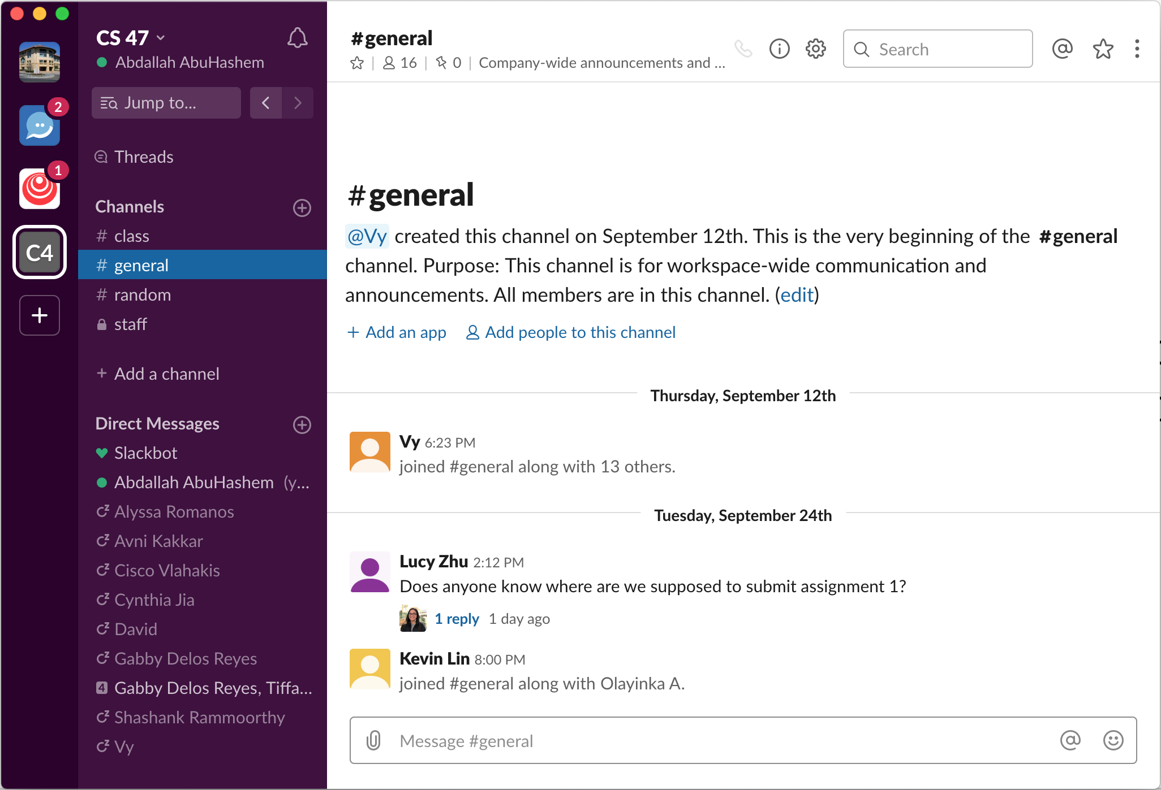
Join our
Slack
https://tinyurl.com/cs47slack2019
cs47-fall19.slack.com
Notes:
Think of slack as the place where you ask questions.

Slide 3
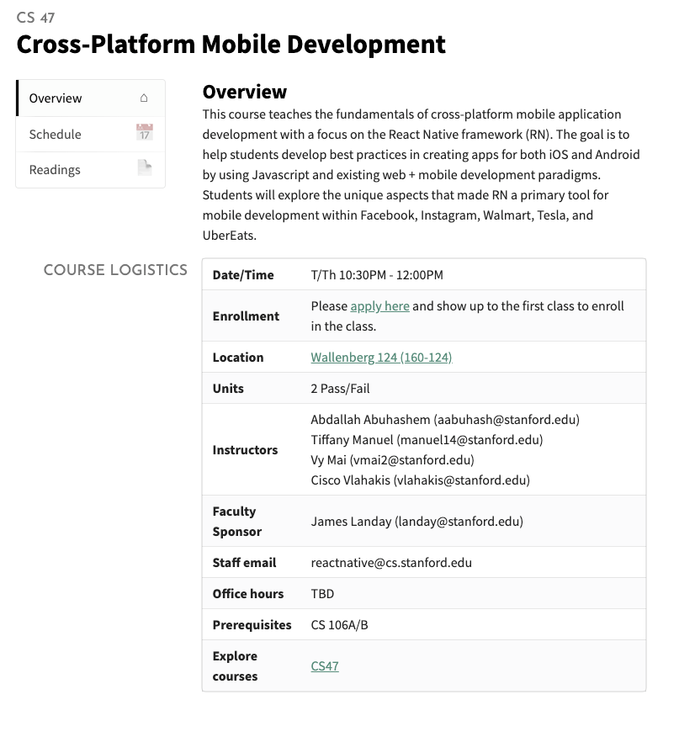
https://cs47.stanford.edu
Notes:
Think of website as a one stop info guide.

Slide 4

Last lecture
Introduced CS47 and React Native as a framework
Briefly touched upon environment setup
Assignment 1 due Tuesday, October 1st, at 11:59 PM
Notes:
Talked a lot about the course and introduced RN. Why we believe in it. How it came to be. Don’t want to spend time doing setup here because your experience will be different.

Slide 5
Why do you want to take this class?
Notes:
This slide is filled based on answers people leave on our first lecture check-in
The check-in includes their infor such as name, year, major, minor, why they’re taking the class, things they wanna learn
Camera for OCR
Personal projects
Firebase, comm
Location
147
Android -> ios

Slide 6
Last lecture
Introduced CS47 and React Native as a framework
Briefly touched upon environment setup
Assignment 1 due Tuesday, October 1st, at 11:59 PM
Notes:
Today we’ll be talking about why react native projects look the way that they do. We will be giving an overview of JavaScript. This JS might be a little different than what you are used to. We will be discussing how.

Slide 7
Last lecture
Introduced CS47 and React Native as a framework
Briefly touched upon environment setup
Assignment 1 due Tuesday, October 1st, at 11:59 PM
Overview for today
Introduce JavaScript Basics
Introduce Babel
Introduce JSX
Create an application from scratch
Breakdown React Native project files
Notes:
Today we’ll be talking about why react native projects look the way that they do. We will be giving an overview of JavaScript. This JS might be a little different than what you are used to. We will be discussing how.

Slide 8

Last lecture
Introduced CS47 and React Native as a framework
Briefly touched upon environment setup
Assignment 1 due Tuesday, October 1st, at 11:59 PM
Overview for today
Introduce JavaScript Basics
Introduce Babel
Introduce JSX
Create an application from scratch
Breakdown React Native project files
Notes:
We will begin by talking about the basics. This will be your transition from CS 106A/B to JS. We might be moving too fast in this lecture, so if you think so, please shout it out, and we’ll make sure to adjust our pace. For some of you, you might be familiar with JS, but used it in the context of HTML with mainly DOM changes. This will probs be very different from the use of JS you’re used to in that case. If you have used JS and ES6, you might find this a bit boring, but we ask you pay attention to make sure you know all what’s going on here.

Slide 9
https://es6console.com/
Notes:
To keep up with what we are presenting, we encourage you to go to this website. It’s just a compiler website for JS that we’ll be using today given that you probs still don’t have your RN environment set up. Also, the focus for now is JS in general to help with RN so keeping it simple is better.

Slide 10

JS: Variables
In ES6, variables:
Don’t have types
But must be declared before using them
Global variables
var x = 1;
if (x === 1) {
var x = 2;
console.log(x);
// expected output: 2
}
console.log(x);
// expected output: 2
Notes:
With variables for me, I always thought of JS as similar to Python. This is not entirely true. It’s not true at all in fact, but one nice similarity is no types! Did I say nice? If you don’t agree come talk to us, you can use typescript! The reason why they are worlds different from python is 1) they have to be declared. You can’t just say x = 1 and roll with it. 2) And this is specific to the newer JS versions like es6 is scopes! Here we have global variable

Slide 11
JS: Variables
In ES6, variables:
Don’t have types
But must be declared before using them
Local variables
let x = 1;
if (x === 1) {
let x = 2;
console.log(x);
// expected output: 2
}
console.log(x);
// expected output: 1
Notes:
Here we have local scope

Slide 12
JS: Variables
In ES6, variables:
Don’t have types
But must be declared before using them
Const variables
const x = 1;
if (x === 1) {
x = 2;
//Error
console.log(x);
// expected output: 2
}
console.log(x);
// expected output: 1
Notes:
Here we have consts

Slide 13
JS: Variables
 | Global Variables | Local Variables | Constant Variables
Use | The scope here is the function in which it’s declared | The scope here is the block in which it is declared | The scope here is the block, but it cannot be changed in value
Syntax | var x = 10; | let x = 10; | const x = 10;

Slide 14
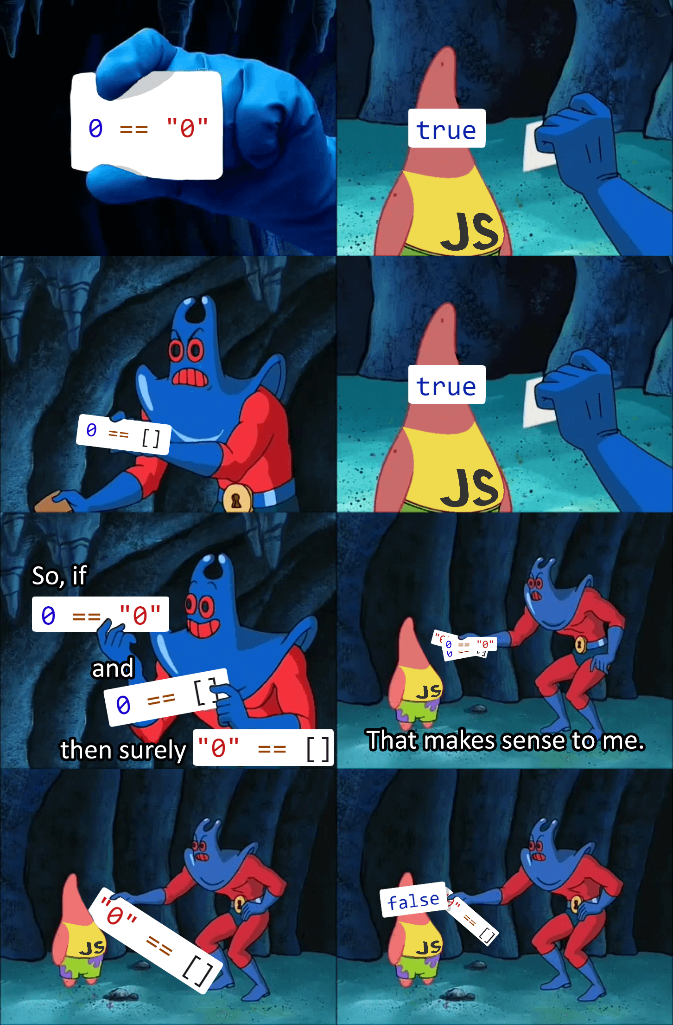
JS: If statements
Notes:
Soooo, you probs saw this meme on meme groups, and as a JS fan I hate it tbh cuz JS is not the problem. JS is like a lotus flower. It needs special care to bloom, but it’s beautiful!

Slide 15
JS: If statements
JS needs special care with equality.
If in doubt use === and !== (or use them always)
Example
if (a > 0) {
return "positive";
} else if (a === 0) {
return "It’s a zero";
} else {
return "NOT positive";
}
Notes:
Basically, with equality, you should always use === and not ==.
Double equality produces truish and falsish results, so it could be surprising like the meme in the previous slide

Slide 16
JS: Loops
You have many options for loops in JS
For loops
for (var i = 0; i < arr.length; i++) {
console.log(arr[i]);
}
For of loops
for (var element of arr) {
console.log(arr);
}
Notes:
Then loops!

Slide 17
JS: Loops
You have many options for loops in JS
For each loops
arr.foreach(function(element) {
console.log(element);
});
While loops
While (true) {
console.log(“You can’t stop me”);
}
Notes:
More loops!

Slide 18
JS: Functions
Functions in JS are declared in the following way
function addition(a, b = 10) {
return a + b;
}
Notes:
JS functions are like you know normal functions for now. Later we will talk more about them, but one thing to keep in mind is that they are objects in JS, and that have interesting implications. You know the this problem?

Slide 19
JS: Functions
Functions in JS are declared in the following way
function addition(a, b = 10) {
return a + b;
}
Another way is as follows
var addition = (a, b = 10) => {
return a + b;
}
Notes:
Use fat arrow to avoid it! It’s v useful especially in RN

Slide 20
JS: Functions
Functions in JS can turn passed in arguments to arrays
function addition(a, ...b) {
return a + b.length;
}
console.log(addition(2,1,7,5));
// 2 + 3 = 5
On the opposite side, we can do
function addition(a, b, c) {
return a + b + c;
}
console.log(addition(...[1,2,3]));
// 1 + 2 + 3 = 6
Notes:
These ways of passing and receiving variables are useful to save time and could also be a way to make sure things are passed as expected

Slide 21
JS: Objects
Objects are similar to dictionaries and/or maps in other languages
let obj = {
name: ‘John’,
age: 17,
};
console.log(obj.name + ‘ ‘ + obj[‘age’]);
Other ways of representing properties
let obj = {
[‘full’ + ‘name’]: ‘John Doe’,
//same as age: age
age,
lorem() {
return “ipsum”;
},
};
Notes:
Objects are quite common to be used in JS as collections of variables. They could have all kinds of variables as properties including functions. As a result, there are a few shorthands to make using them smoother.
1- Computed properties
2- Same key and value variables
3- Methods

Slide 22

Last lecture
Introduced CS47 and React Native as a framework
Briefly touched upon environment setup
Assignment 1 due Tuesday, October 1st, at 11:59 PM
Overview for today
Introduce JavaScript Basics
Introduce JSX
Create an application from scratch
Breakdown React Native project files
Notes:
Questions?

Slide 23
Last lecture
Introduced CS47 and React Native as a framework
Briefly touched upon environment setup
Assignment 1 due Tuesday, October 1st, at 11:59 PM
Overview for today
Introduce JavaScript Basics
Introduce JSX
Create an application from scratch
Breakdown React Native project files
Notes:
JSX

Slide 24



Notes:
But before we dive too deep into this, let’s put some cross-platform UI design solutions into perspective.

Slide 25
Notes:
First we have iOS.

Slide 26
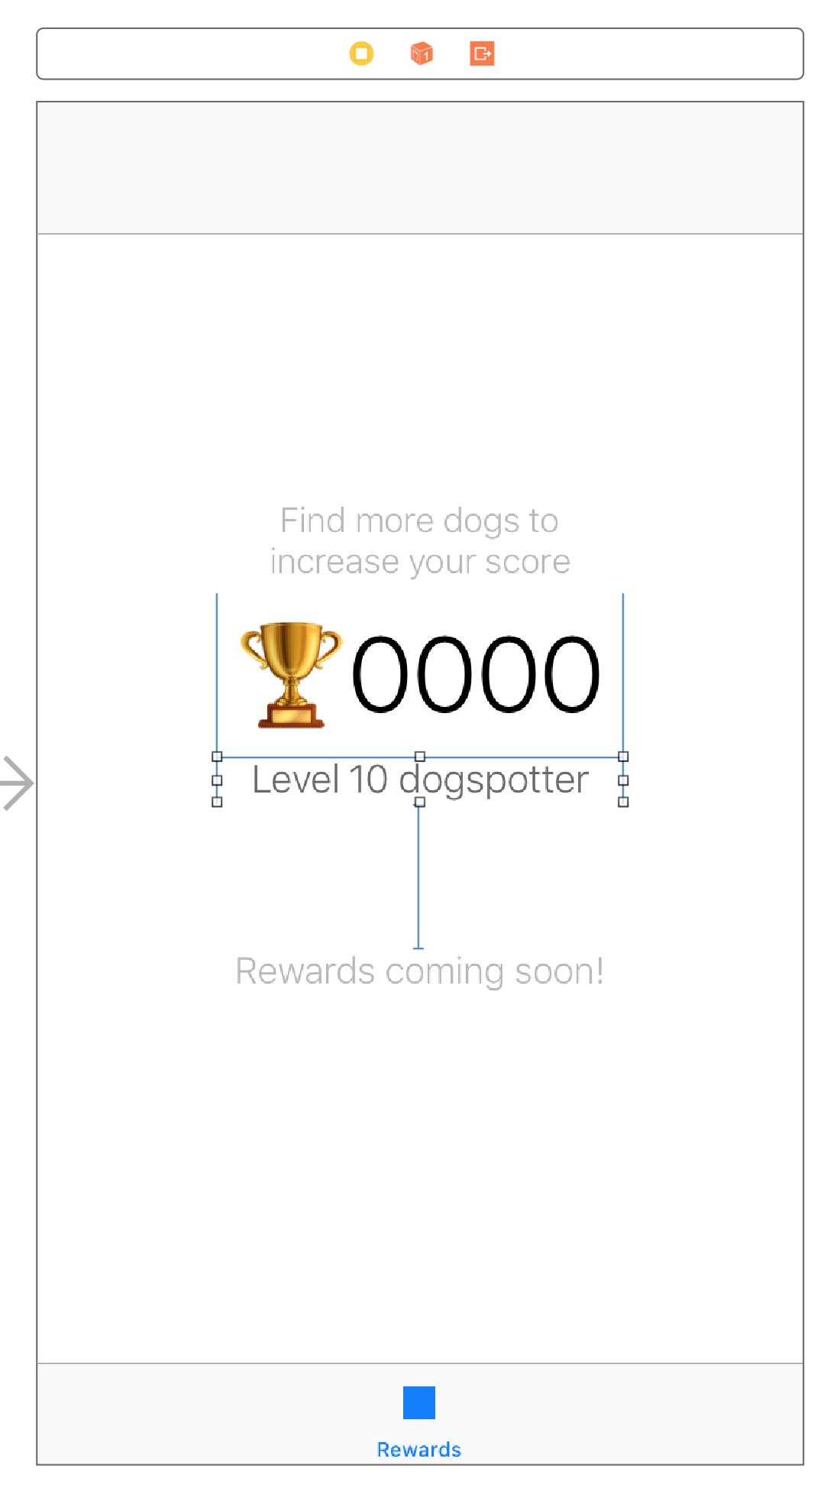
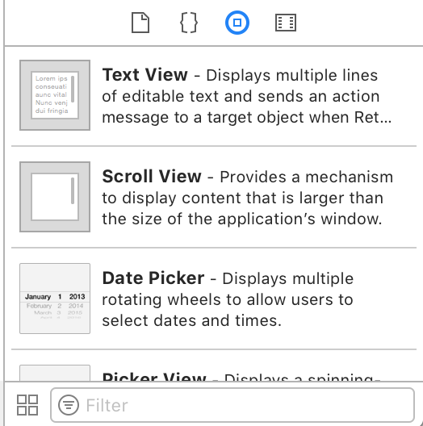
Notes:
Using Xcode we get a “drag and drop” interface.

Slide 27

Unfortunately you will have to deal with autolayout constraints
Notes:
Autolayout
There’s also a way to code things directly...

Slide 28
let textLayer = CATextLayer() textLayer.backgroundColor = color.cgColor
textLayer.foregroundColor = UIColor.white.cgColor textLayer.frame = frame textLayer.alignmentMode = kCAAlignmentLeft textLayer.isWrapped = true let font = CTFontCreateWithName("System" as CFString, 18.0, nil) textLayer.font = font textLayer.fontSize = 18.0 textLayer.contentsScale = UIScreen.main.scale textLayer.string = label self.view.layer.addSublayer(textLayer)
Notes:
And in fact, this is what Apple does internally. They build their stuff via code.
Beginners still prefer auto layout.

Slide 29
let textLayer = CATextLayer() ... self.view.layer.addSublayer(textLayer)
Notes:
Then there’s Android

Slide 30
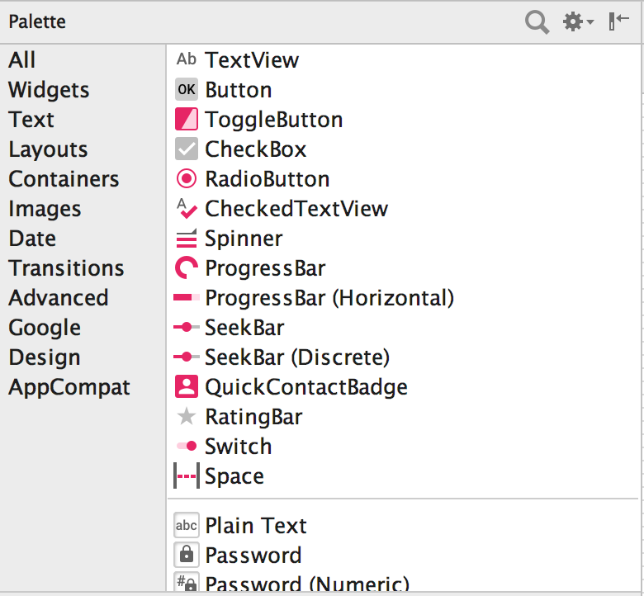
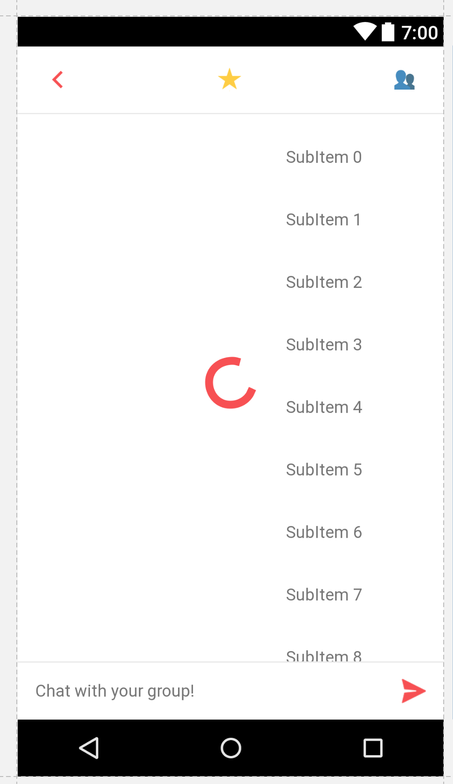
LinearLayout myLayout = findViewById(R.id.main); Button myButton = new Button(this); myButton.setLayoutParams(new LinearLayout.LayoutParams(
LinearLayout.LayoutParams.MATCH_PARENT, LinearLayout.LayoutParams.MATCH_PARENT)); myLayout.addView(myButton);
let textLayer = CATextLayer() ... self.view.layer.addSublayer(textLayer)
Notes:
Android also has a drag and drop interface.
Also supports building layouts via code.
In addition to this, however,

Slide 31
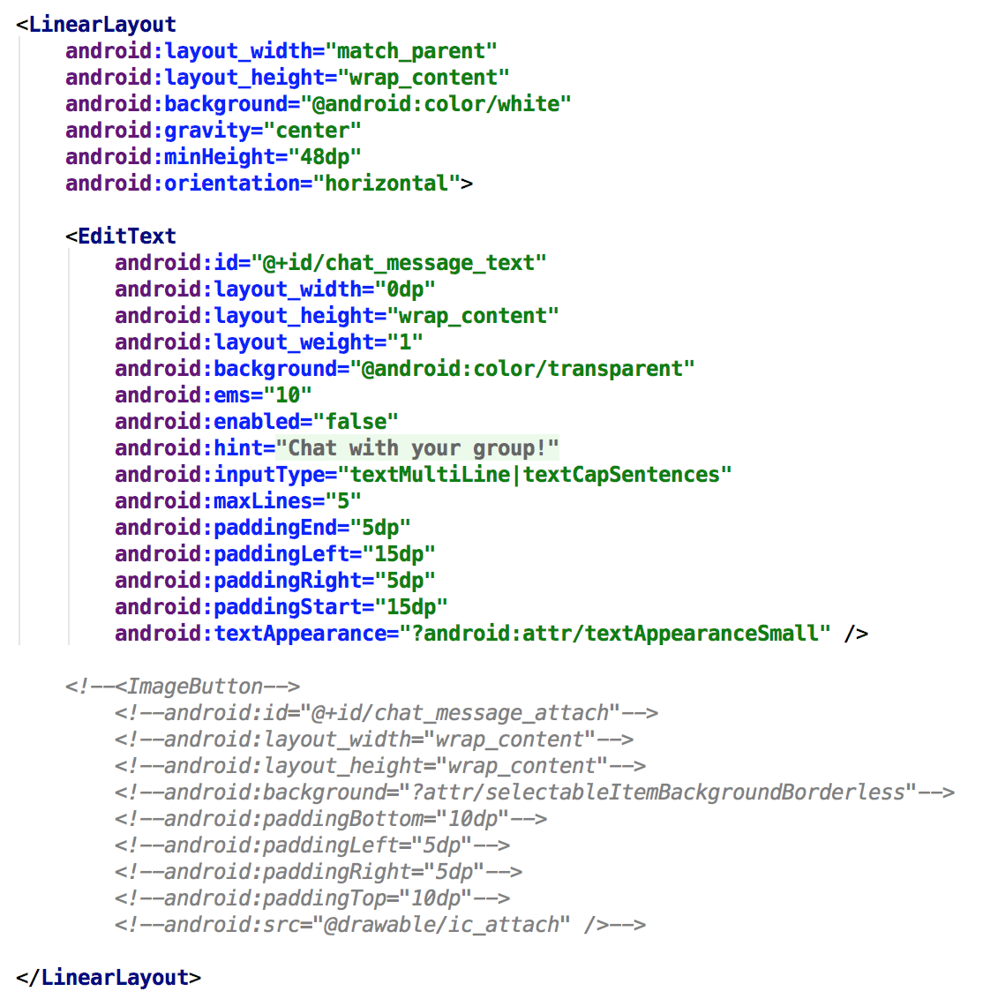
LinearLayout myLayout = findViewById(R.id.main); Button myButton = new Button(this); myButton.setLayoutParams(new LinearLayout.LayoutParams(
LinearLayout.LayoutParams.MATCH_PARENT, LinearLayout.LayoutParams.MATCH_PARENT)); myLayout.addView(myButton);
let textLayer = CATextLayer() ... self.view.layer.addSublayer(textLayer)
Notes:
In addition to this, however, Android cleanly integrates with XML.
Advanced Android developers tend to build UI using XML directly because this drag and drop interface is really bad..

Slide 32
let textLayer = CATextLayer() ... self.view.layer.addSublayer(textLayer)
Notes:
Finally, we have react native

Slide 33
How do we build layouts in React Native?
Notes:
Answer is...

Slide 34
How do we build layouts in React Native?
Programmatically (in markup style) — this means no drag and drop interface builder.
Notes:
For context let’s go through some history...

Slide 35
Originally, the process of creating a View using React looked like this:
var ourView = React.createElement(View, null);
Notes:
Notice that we’re calling raw Javascript code to achieve this.
If you don’t know what a View is, it’s basically

Slide 36

Originally, the process of creating a View using React looked like this:
var ourView = React.createElement(View, null);
Notes:
If you don’t know what a View is, it’s basically a canvas.
You need to set a view down before adding components to your app, just like you need to set a canvas down before painting.
A later lecture will elaborate on this more.
So how exactly do we add something to our view?

Slide 37
Originally, the process of nesting Text within a View using React looked like this:
var ourNestedView = React.createElement( View, { foo: 'bar'}, React.createElement( Text, null, '42' ) );
Notes:
This process of nesting components looked like this…
This basically translates...

Slide 38
Originally, the process of nesting Text within a View using React looked like this:
var ourNestedView = React.createElement( View, { foo: 'bar'}, React.createElement( Text, null, '42' ) );
42
Notes:
This basically translates into a canvas with text.
We don’t create layouts like this anymore. Why? Because of JSX
Cue JSX..

Slide 39
JSX
An extension to JavaScript that you will use to build your UI interfaces.

Slide 40
Without JSX
var ourNestedView = React.createElement( View, { foo: 'bar'}, React.createElement( Text, null, '42' ) );
42
Notes:
JSX takes this nasty code...

Slide 41
With JSX
const ourNestedView = ( <View foo='bar'> <Text>42</Text> </View> )
42
Notes:
And turns it into this.

Slide 42
JSX
No JSX
const ourNestedView = ( <View foo='bar'> <Text>42</Text> </View> )
var ourNestedView = React.createElement( View, { foo: 'bar'}, React.createElement( Text, null, '42' ) );
JSX is a shortcut for using the React.createElement() API

Slide 43
JSX Benefits
const ourNestedView = ( <View foo='bar'> <Text>42</Text> </View> )
UI has a clear hierarchical structure. What you see in code mirrors what you will get.
Notes:
If you see a Text component inside of a View, you will get Text inside of a view

Slide 44
JSX Benefits
const ourNestedView = ( <View foo='bar'> <Text>42</Text> </View> )
UI has a clear hierarchical structure. What you see in code mirrors what you will get.
42
Notes:
If you see a Text component inside of a View, you will get Text inside of a view

Slide 45
JSX Benefits
const ourNestedView = ( <View foo='bar'> <Text>42</Text> </View> )
UI has a clear hierarchical structure. What you see in code mirrors what you will get.
This makes it easier for designers to contribute to code.

Slide 46
JSX Benefits
const ourNestedView = ( <View foo='bar'> <Text>42</Text> </View> )
UI has a clear hierarchical structure. What you see in code mirrors what you will get.
This makes it easier for designers to contribute to code.
You get the accessibility of templates AND the power of JS.
Notes:
RN updates JSX View API to render an element as needed in later versions.

Slide 47
let textLayer = CATextLayer() ... self.view.layer.addSublayer(textLayer)
const ourNestedView = ( <View foo='bar'> <Text>42</Text> </View> )
Notes:
This means that you get a pretty clean end result.
And with everyone designing layouts exactly like you do, you bet there’s a lot of available support out there.
You also don’t really need a drag and drop interface builder when your app hot reloads anyways.

Slide 48
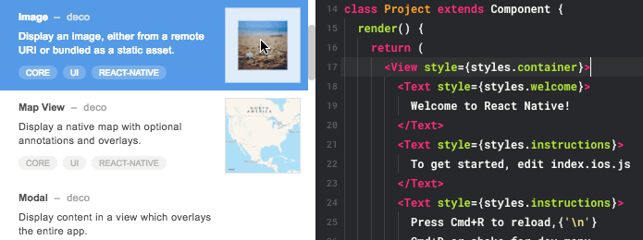
const ourNestedView = ( <View foo='bar'> <Text>42</Text> </View> )
Notes:
There are IDEs that offer some kind of interface building functionality, though limited. In this class we will only be using JSX to create our layouts. It’ll become second nature quickly.

Slide 49
let textLayer = CATextLayer() ... self.view.layer.addSublayer(textLayer)
const ourNestedView = ( <View foo='bar'> <Text>42</Text> </View> )
Notes:
Building a layout with JSX once and having it work on both iOS and Android is priceless.
Imagine all of the time you saved.

Slide 50
Last lecture
Introduced CS47 and React Native as a framework
Briefly touched upon environment setup
Assignment 1 due Tuesday, October 1st, at 11:59 PM
Overview for today
Introduce JavaScript Basics
Introduce JSX
Create an application from scratch
Breakdown React Native project files
Notes:
JSX

Slide 51
Last lecture
Introduced CS47 and React Native as a framework
Briefly touched upon environment setup
Assignment 1 due Tuesday, October 1st, at 11:59 PM
Overview for today
Introduce JavaScript Basics
Introduce JSX
Create an application from scratch
Breakdown React Native project files
Notes:
Next we’ll be talking about why react native projects look the way that they do.

Slide 52
Creating an empty project

Slide 53
render() { return ( <View style={styles.container}> <Text>Open up App.js to start working on your app!</Text> <Text>Changes you make will automatically reload.</Text> <Text>Shake your phone to open the developer menu.</Text> </View> ); }
Notes:
This is just rendering JSX markup. What renders depends on what is returned.

Slide 54
render() { return ( <View style={styles.container}> <Text>Open up App.js to start working on your app!</Text> <Text>Changes you make will automatically reload.</Text> <Text>Shake your phone to open the developer menu.</Text> </View> ); }
const ourNestedView = ( <View foo='bar'> <Text>42</Text> </View> )
Notes:
Our nested view can just be returned directly.

Slide 55
render() { return ourNestedView; }
const ourNestedView = ( <View foo='bar'> <Text>42</Text> </View> )
Notes:
As long as ourNestedView is defined within scope.

Slide 56
render() { return ( <View style={styles.container}> <Text>Open up App.js to start working on your app!</Text> <Text>Changes you make will automatically reload.</Text> <Text>Shake your phone to open the developer menu.</Text> </View> ); }
Notes:
Now, what exactly is going on here?

Slide 57
render() { return ( <View style={styles.container}> <Text>Open up App.js to start working on your app!</Text> <Text>Changes you make will automatically reload.</Text> <Text>Shake your phone to open the developer menu.</Text> </View> ); }
React Native calls the render function every time a change occurs.
Notes:
Make change. Save file. Application is reloaded instantly.

Slide 58
render() { return ( <View style={styles.container}> <Text>Open up App.js to start working on your app!</Text> <Text>Changes you make will automatically reload.</Text> <Text>Shake your phone to open the developer menu.</Text> </View> ); }
React Native calls the render function every time a change occurs.
Sneak Peek: there’s something called the “state” of a component. It’s basically a variable that says what to render. When the values of this variable are changed, the render function is called again. You will learn more about a component’s state on week 2.
Notes:
For now, an important detail is that React Native also re-renders a component whenever its state changes.
You might’ve noticed that this reloading occurs almost instantaneously. This is...

Slide 59
Virtual DOM (Document Object Model)
A virtual representation of a desired view state
(not necessarily the same thing as the DOM on a browser)
Notes:
This is because of the fact that React Native uses a virtual DOM.

Slide 60
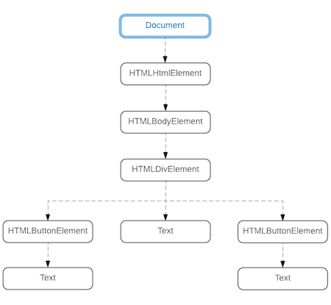
Virtual DOM (Document Object Model)
Notes:
In a browser, the virtual DOM can look something like this. It’s a representation of what is rendered and where.

Slide 61
render() { return ( <View style={styles.container}> <Text>Open up App.js to start working on your app!</Text> <Text>Changes you make will automatically reload.</Text> <Text>Shake your phone to open the developer menu.</Text> </View> ); }
React Native calls the render function every time a change occurs.
Notes:
Now where does the virtual DOM fall into place in this picture? You might be thinking that re-rendering an entire nested View component every time you make a change is really expensive and slow. What if you have 100 text components?

Slide 62
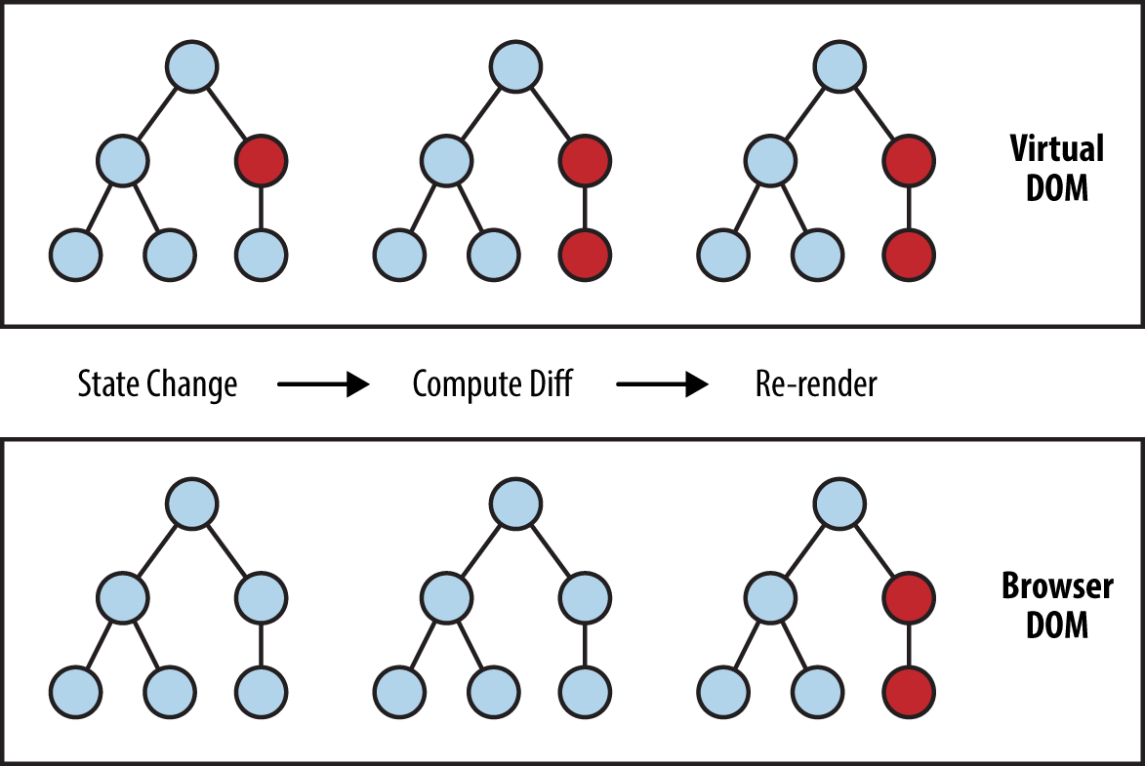
React Native
Components
Notes:
The virtual DOM computes the difference in the DOM after a state change and only re-renders the affected nodes.
Change text here
Affects related node
V DOM reports change
RN reloads only affected

Slide 63
React Native
Components
Notes:
How does this rendering step happen?
Answer is why it’s called React “Native”

Slide 64
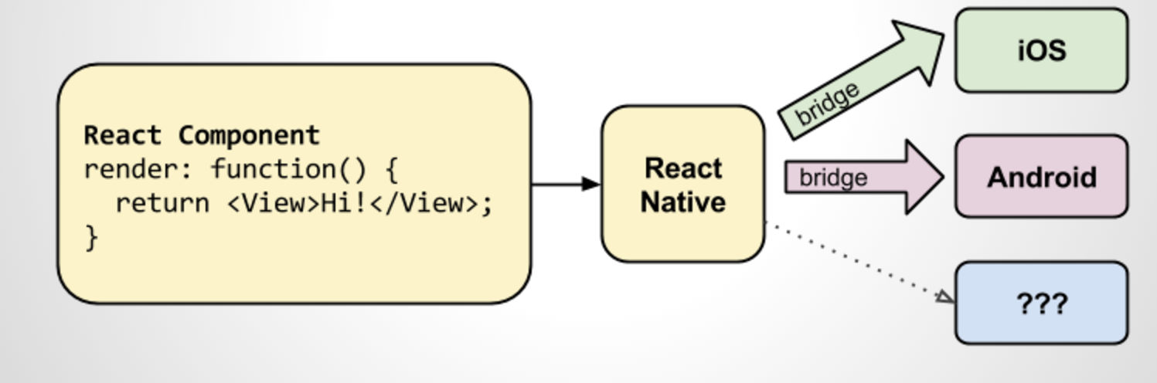
Notes:
Technically any other platform is supported as long as somebody writes that translation bridge.

Slide 65
const ourNestedView = ( <View foo='bar'> <Text>42</Text> </View> )
View
UIView
TextView
UILabel
Notes:
How does the bridge work?
If we tell RN to render a view… These platforms will never know what this JSX is. Instead, they will directly render their native components.
You might start to see the value of writing code once and having it work on both platforms automatically. Possibilities are endless.

Slide 66
Back to project
Notes:
life-cycle of a project

Slide 67
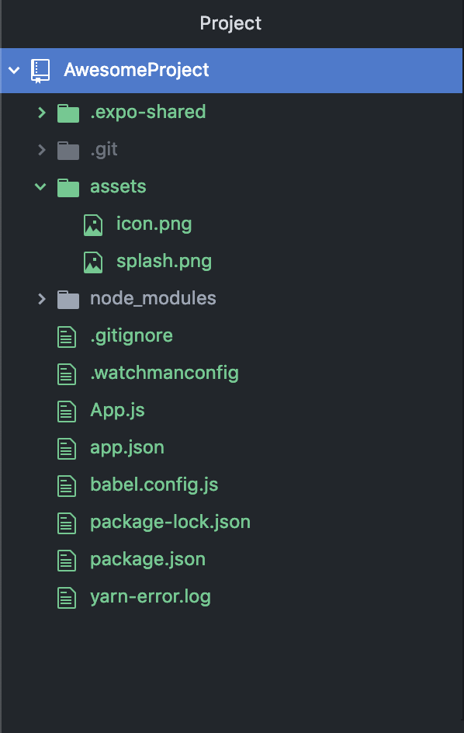
.expo-shared | hidden folder, !important
.git | hidden folder, git info, !imp
assets | project assets e.g. icon
node_modules | all modules for project
.gitignore | hidden file, git stuff, !imp
.watchmanignore | hidden file, !imp
App.js | Your code, very very important
app.json | app metadata, !too imp
Babel.config.js | !imp unless you know babel
Package-lock.json | auto gen, modules config
Package.json | packages of your project, imp
yarn-error.log | !imp, error log
Notes:
We will elaborate on this a lot more, but for now… have this cheat sheet

Slide 68
const styles = StyleSheet.create({ container: { flex: 1, backgroundColor: '#fff', alignItems: 'center', justifyContent: 'center', }, });
Basically “CSS” brought to a mobile platform
https://github.com/vhpoet/react-native-styling-cheat-sheet
Notes:
We will elaborate on this a lot more, but for now… have this cheat sheet

Slide 69
Office Hours
OH start on week 2. Email us directly if you’re not available at these times
Abdallah AbuHashem
Monday (12-1 PM) @ Huang Basement
By appointment
Vy Mai
Tuesday (3-4 PM) @ Old Union
By appointment
Cisco Vlahakis
Wednesday (8-9 PM) @ Huang Basement
By appointment
Tiffany Manuel
Thursday (2-3 PM) @ Huang Basement
By appointment

Slide 70
CS47: Cross-Platform Mobile Development
Lecture 1B: Introduction to Javascript (ES6)
James Landay
Abdallah AbuHashem
Tiffany Manuel
Cisco Vlahakis
Vy Mai
Fall 2019
https://cs-47.stanford.edu
cs-47.slack.com

